Slide 1
Simple Curve Detection
CMPUT 206
Nilanjan Ray
Some slide materials taken from www.imagingbook.com

Slide 2
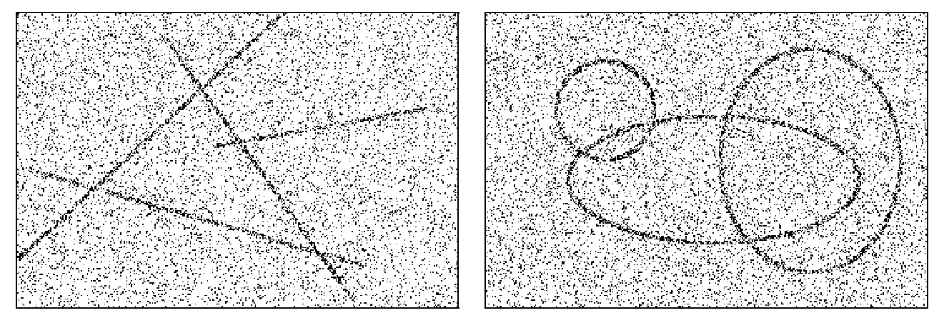
Detecting simple curves
How can we detect these curves?

Slide 3
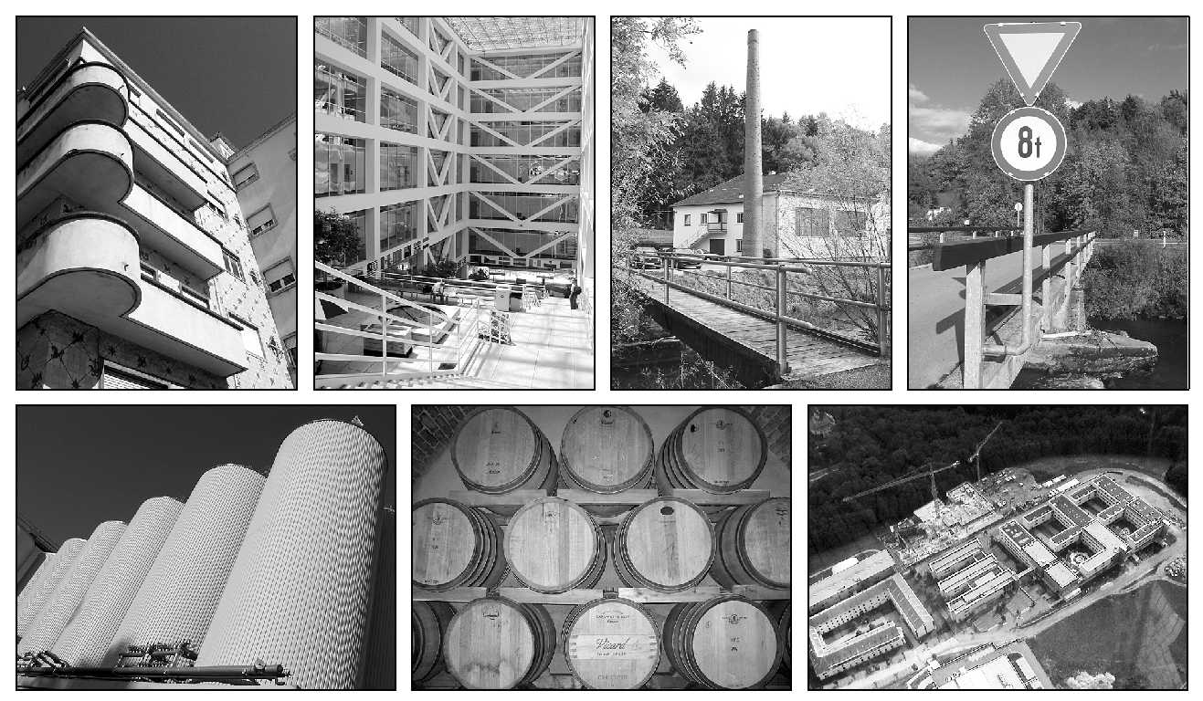
Realistic examples
These are simple parametric curves we want to detect

Slide 4
Hough Transform
Widely used method for detecting parametric curves
Straight lines
Circles
Ellispes
…
Generalized Hough transform can detect a general curve

Slide 5
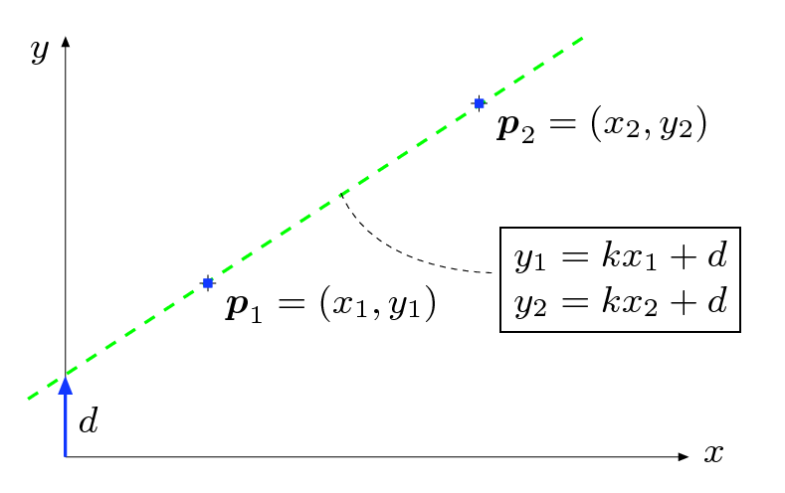
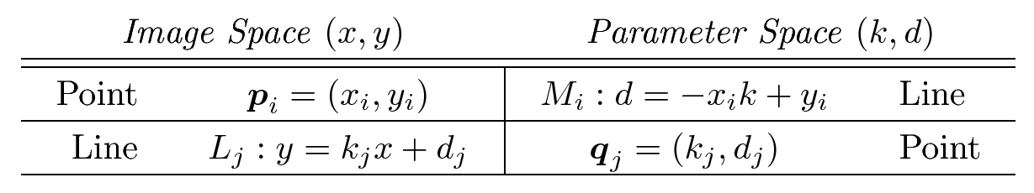
Detecting straight lines
Parametric
form of a
straight line
Dual relationship

Slide 6
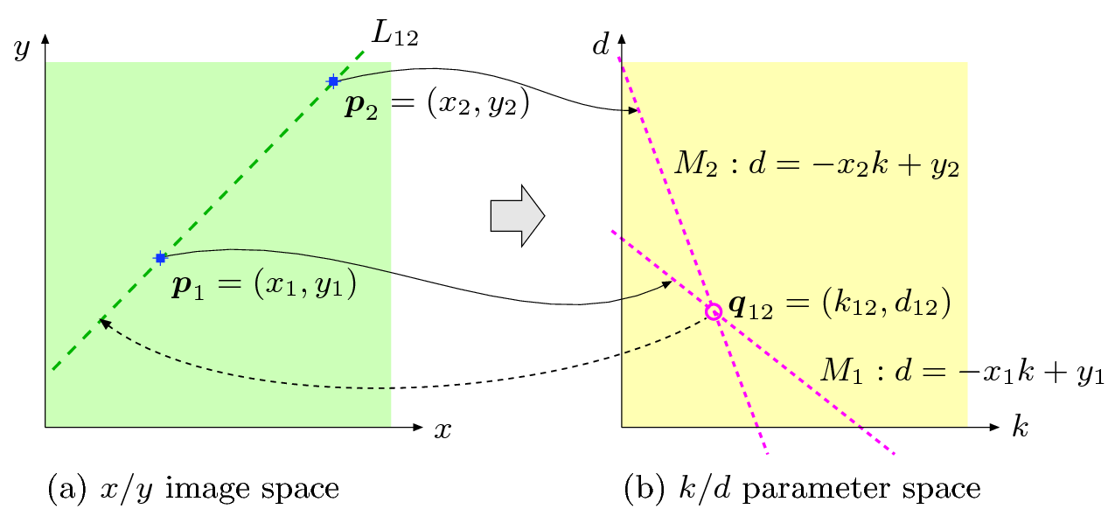
Detecting straight lines
Hough transform: for each point detected on the image space draw a straight
line in the parameter space. The intersection point of all straight lines in the parameter
space identifies a straight line in the image space.

Slide 7
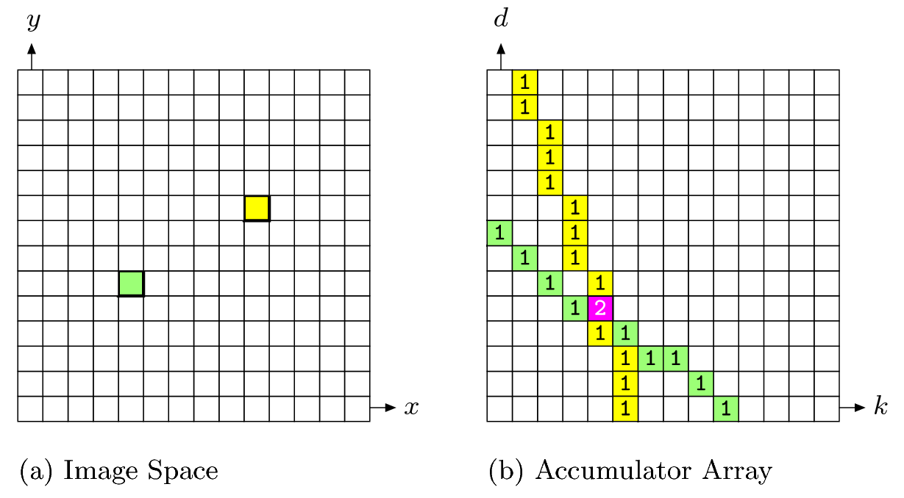
HT: a simple example

Slide 8
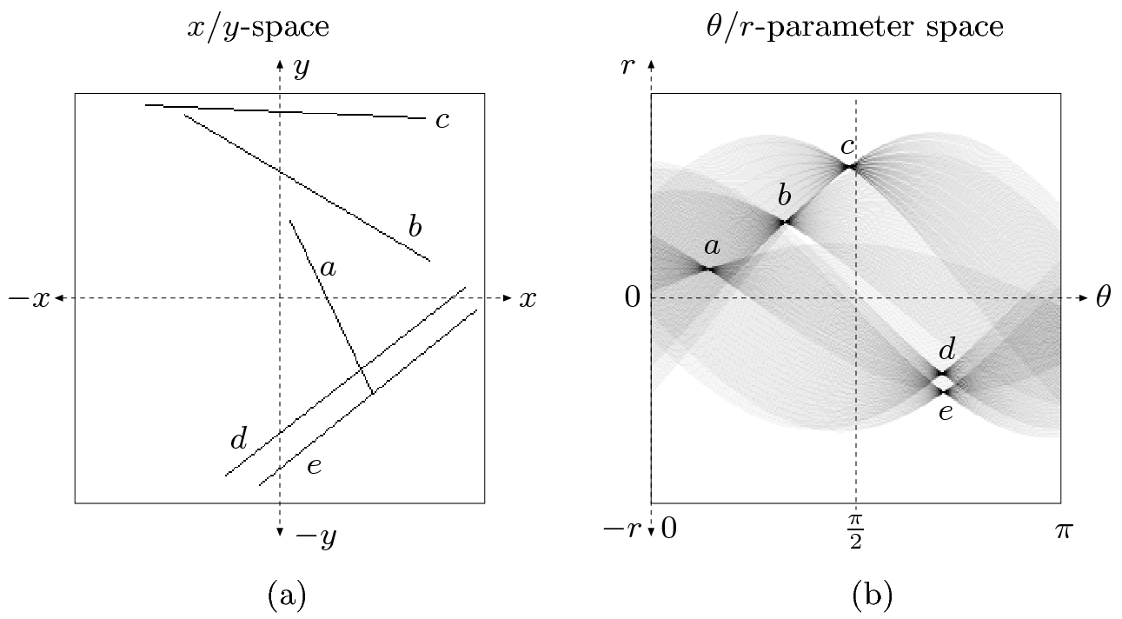

HT: Computationally better parametric form…
What’s wrong with the other parametric form?

Slide 9

HT Straight Line Detection
Use a polar parameterization for a straight line
d is the perpendicular distance from origin to the line
θ is the angle this perpendicular makes with the x axis
HT algorithm
Initialize H matrix to zero
for each edge point I[y, x] in the image
for θ = 0 to 2*pi
H[d, θ] = H[d, θ] + 1
Find the value(s) of (d, θ) where H[d, θ] is locally maximum and greater than a threshold value
The detected line in the image is given by these (d, θ) values

Slide 10
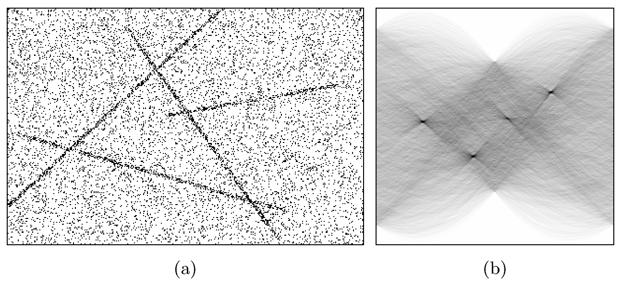
HT: Example

Slide 11
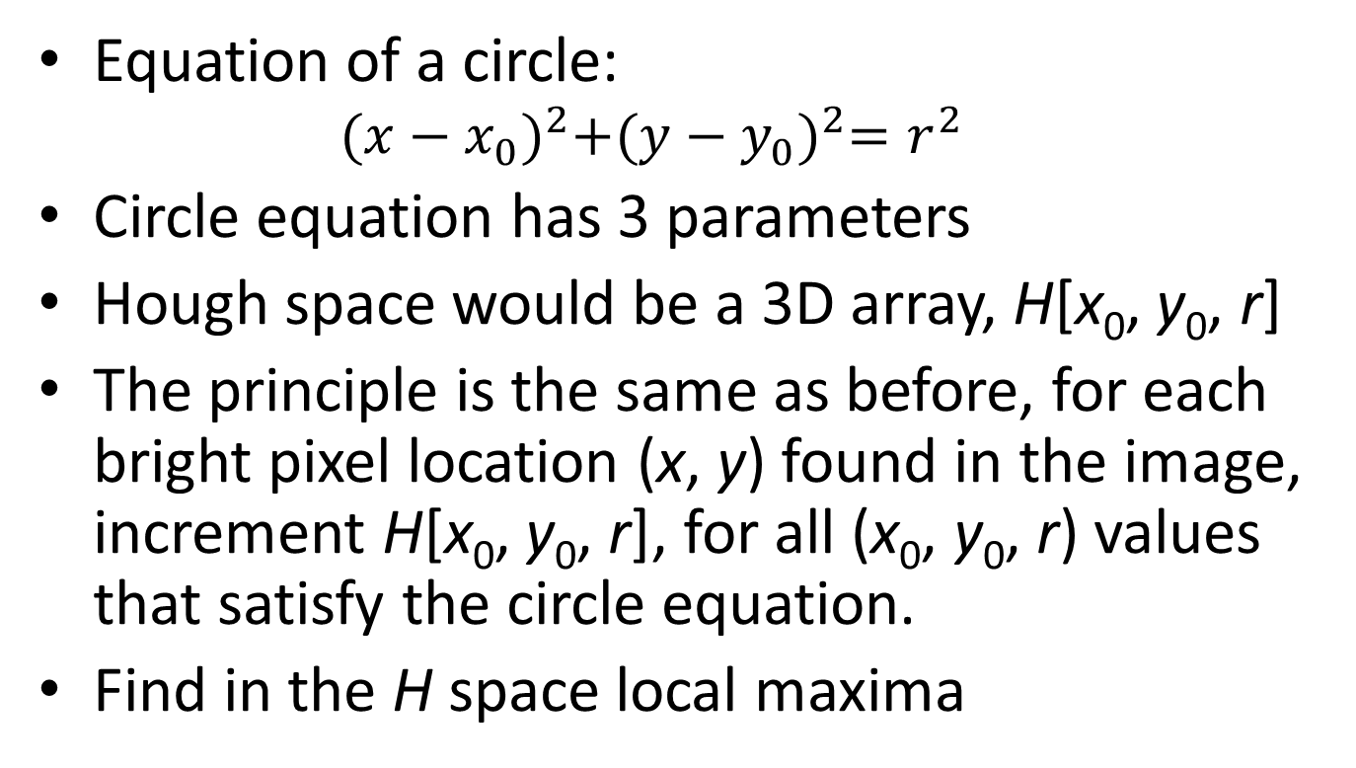
Circle Detection with HT
Equation of a circle:
$${(x−x_{0})}^{2}+{(y−y_{0})}^{2}=r^{2}$$
Circle equation has 3 parameters
Hough space would be a 3D array, H[x₀, y₀, r]
The principle is the same as before, for each bright pixel location (x, y) found in the image, increment H[x₀, y₀, r], for all (x₀, y₀, r) values that satisfy the circle equation.
Find in the H space local maxima

Slide 12
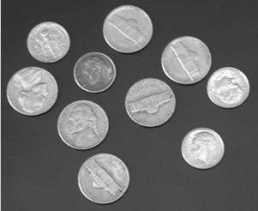
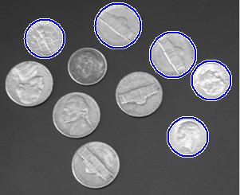
Circle Detection…
Five strongest circles

